Slide 1
ADVISOR: MATTHEW POST
CLIENT: TRUEFORCE TECHNOLOGIES
SDMAY25-10
DETAILED
DESIGN
TESSA LANZEL, PAIGE SCHNEIDER, MOLLY ROONEY, MAY EDEL, ELICIA BARANOWSKI, ALEXANDRA RAUER, JOSHUA STEVEN CHIANG

Slide 2
OVERVIEW
Develop a mobile application for both Google Play Store and Apple App store using their native language
Apps will connect to existing firmware and database to display and store user’s force output for each lift and metrics over a period of time

Slide 3
PROBLEM
Unknown knowledge for what weights will improve strength without injuring
Current data is not transferable across devices
No security
Current Application is full of bugs
Availability to users

Slide 4
DESIGN

Slide 5
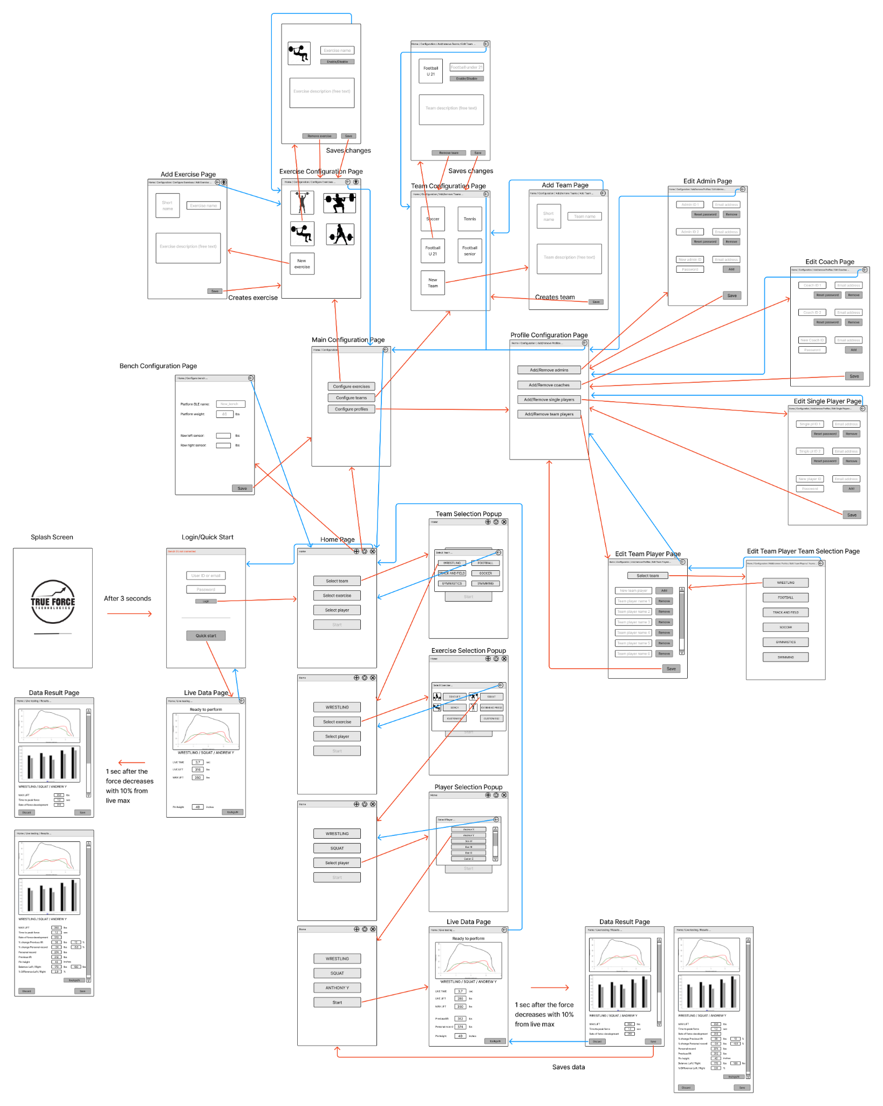
DESIGN

Slide 6
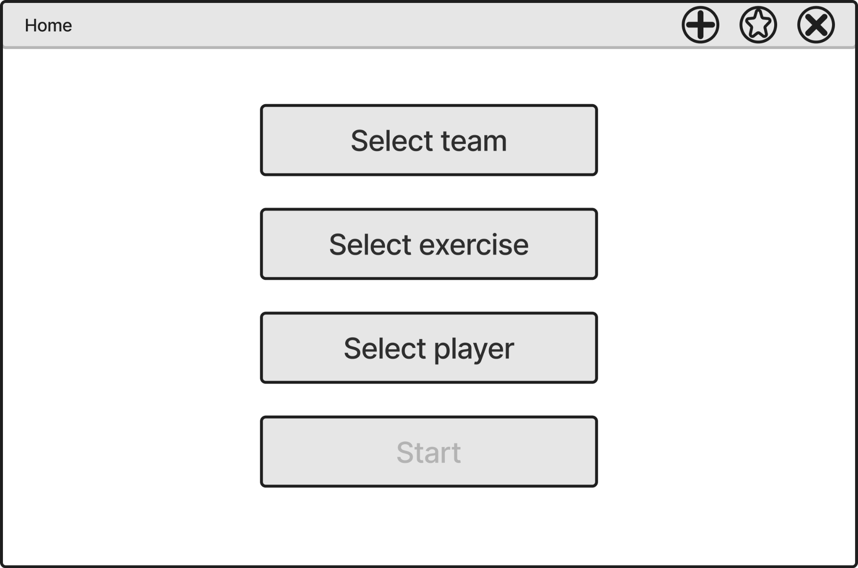
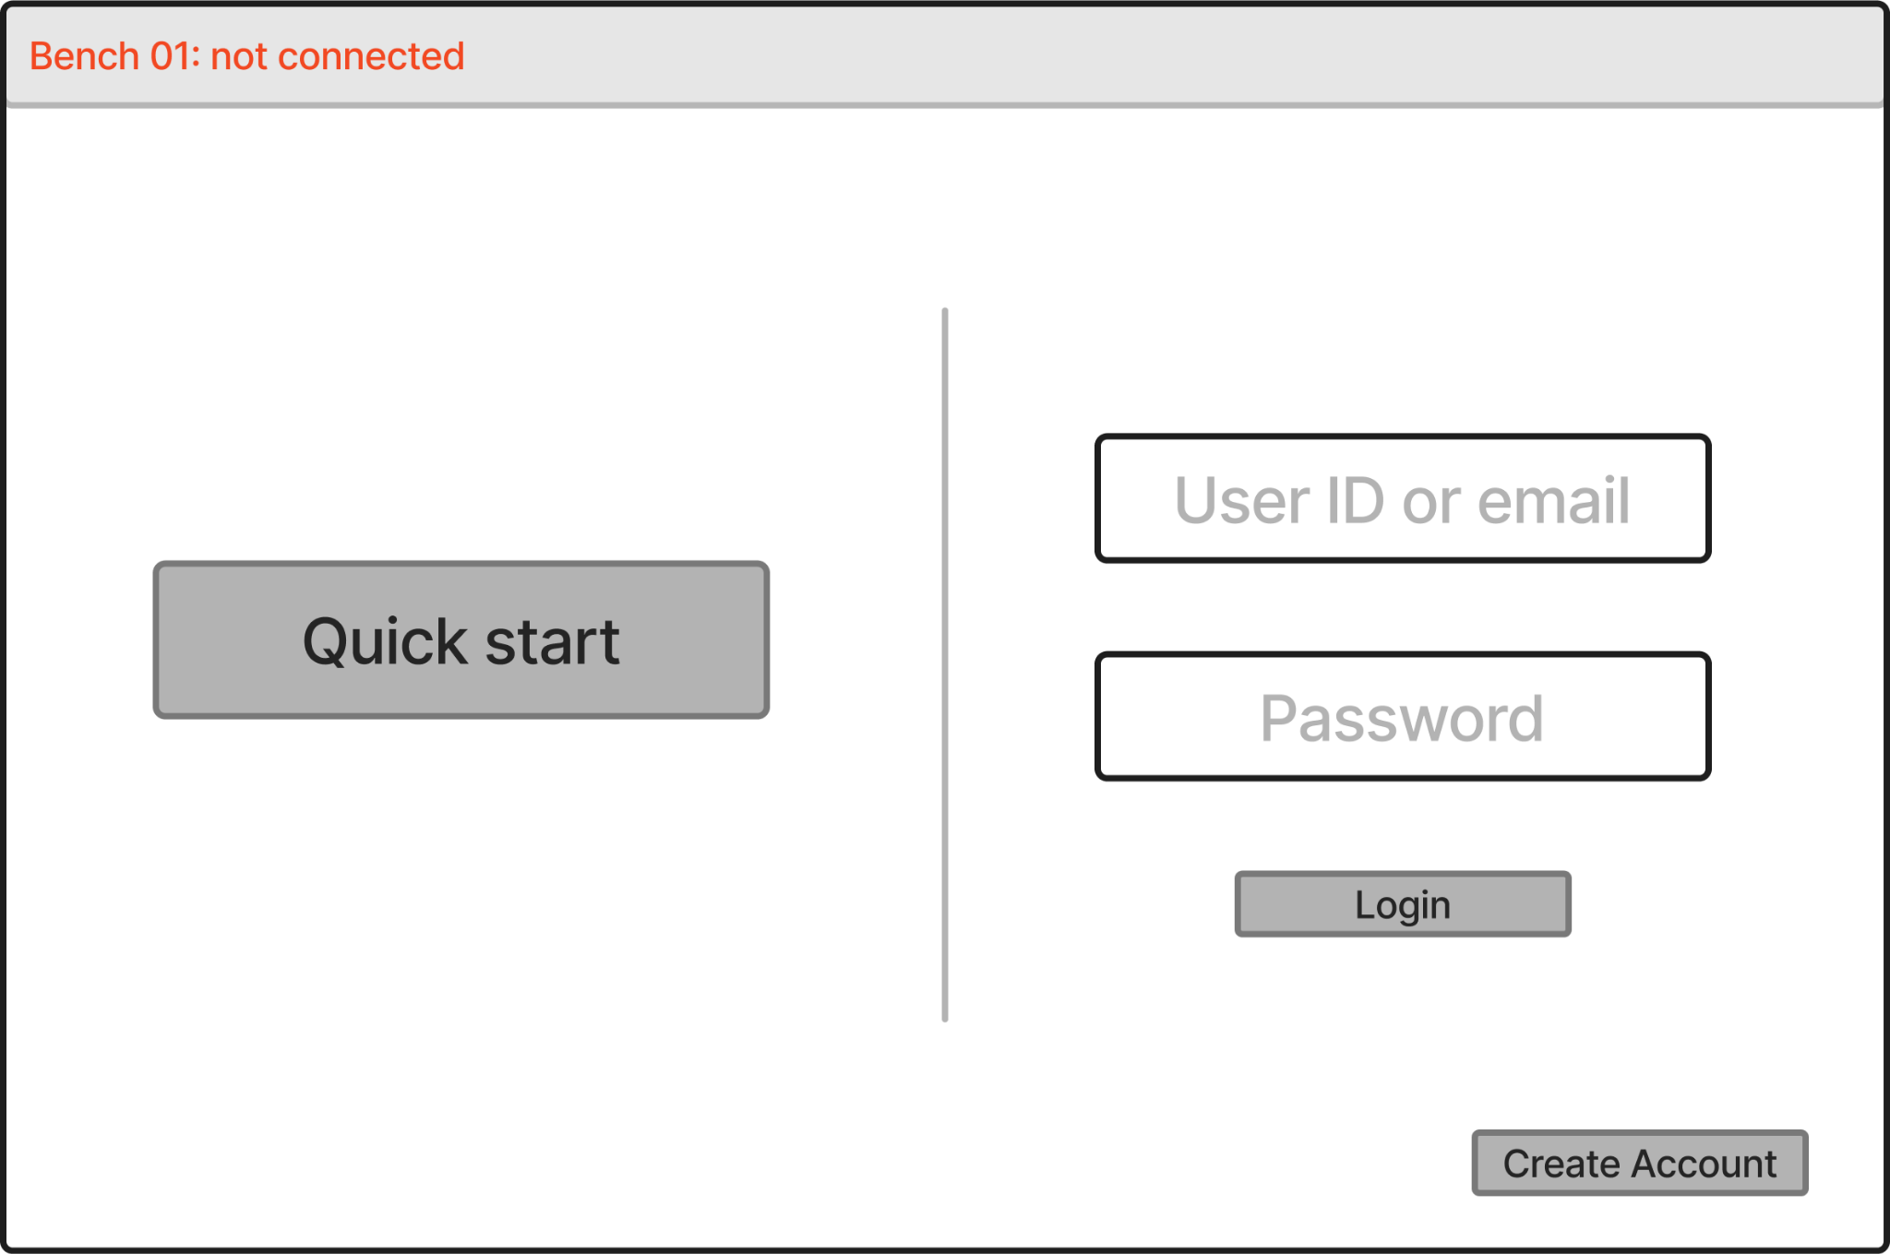
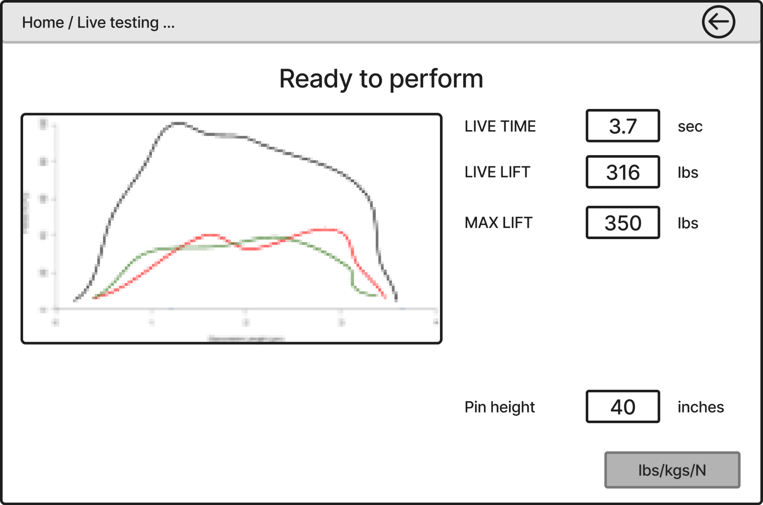
SPLASH SCREEN & LOGIN
Splash Screen
Displays True Force Logo until the application loads
Login Page
Text field for user to enter their username and password
Option to create an account
Alternate option for quick start to do a lift without an account

Slide 7
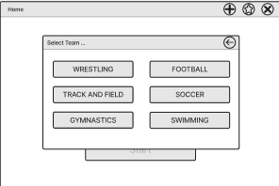
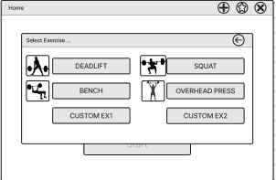
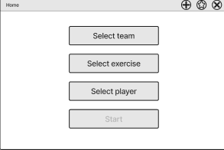
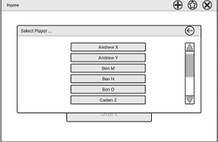
HOME SCREEN
Opens PopUps to select option for each category

Slide 8
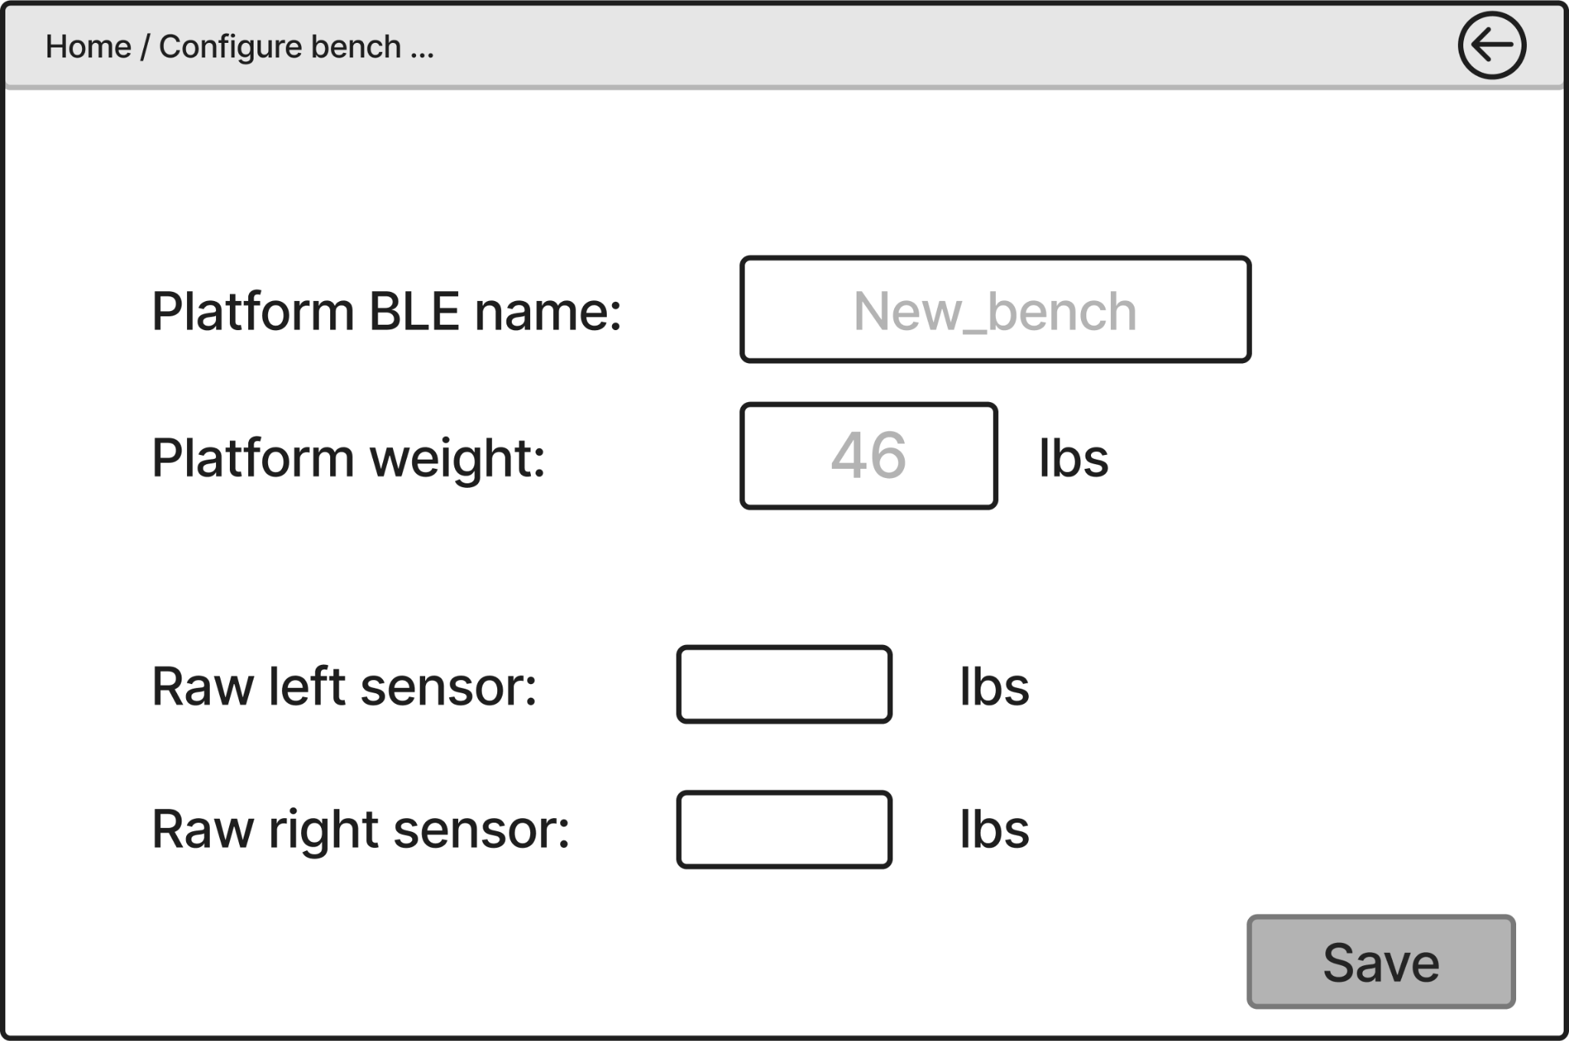
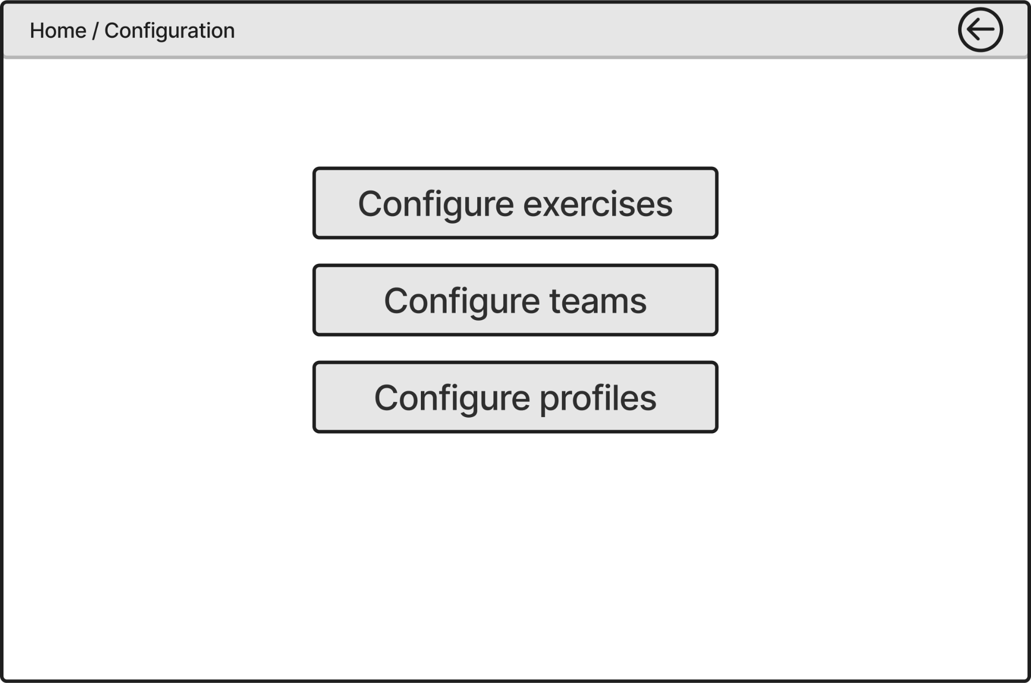
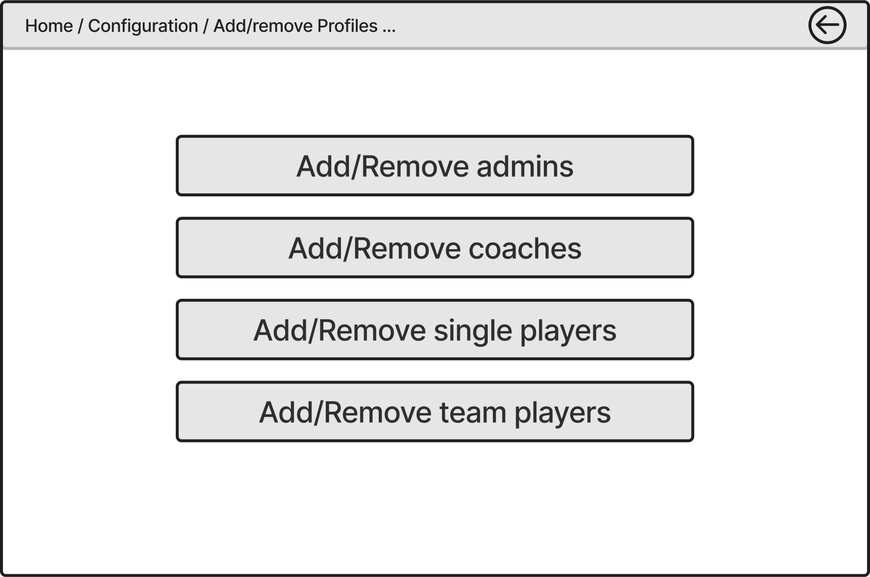
SELECTIONS
Selects specific details about about the rack and configurations.
Plus goes to bench configuration
Star goes to configuration page

Slide 9
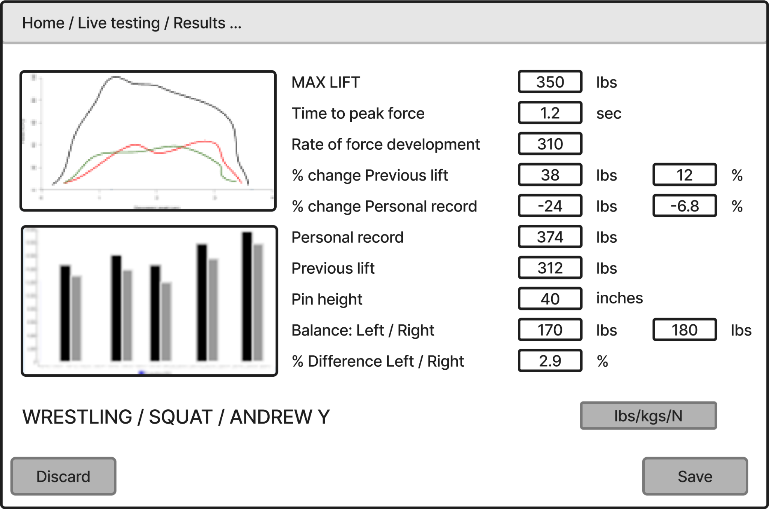
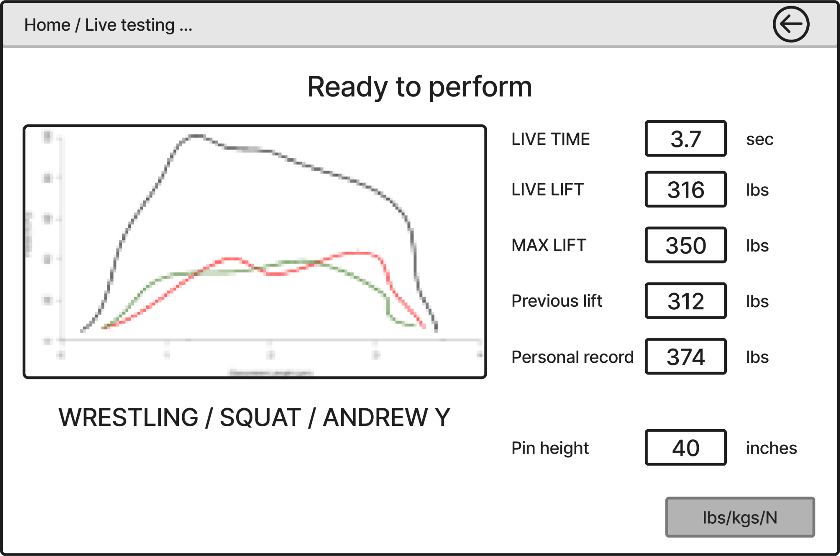
LIVE DATA & RESULTS
When rack is being used, live data will be displayed and updated
When readings drop by 90%, the results page will display
Results page will display that lift and previous stats

Slide 10
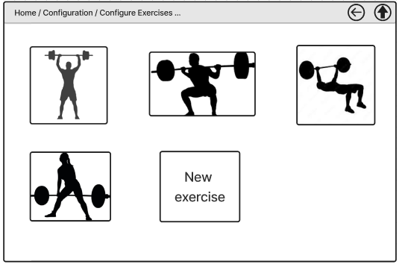
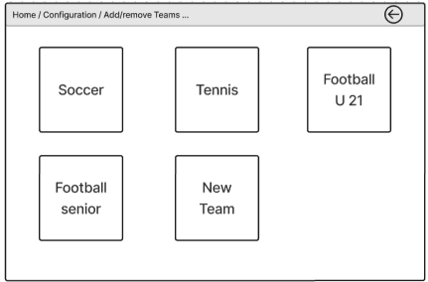
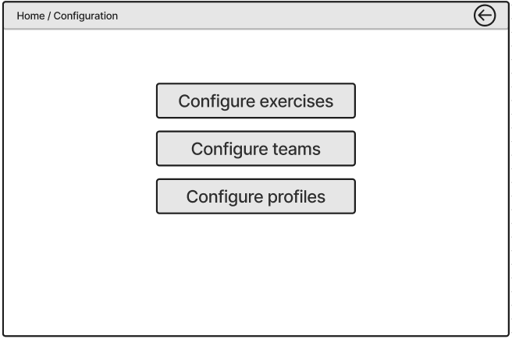
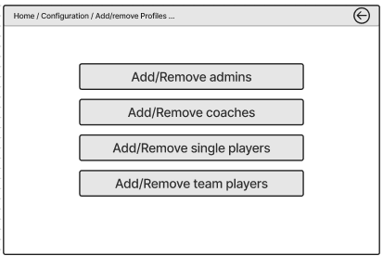
MAIN CONFIGURATION
Main configuration : offers choices for configuring exercises, teams, or profiles
Exercise configuration: users are able to add a new exercise or edit an existing exercise
Team configuration: users are able to add a new team or edit an existing team
Profile configuration: offers users choices for adding or removing admins, coaches, single players, or team players

Slide 11
BENCH CONFIGURATION
Sets up the rack initially
Configure the pressure sensors

Slide 12
TECHNOLOGY CONSIDERATIONS
Frontend
Backend
Bluetooth &
Hardware
iOS (Swift) & Android (Java)
Existing Backend
Strengths: Full access to platform features, better performance, and native feel
Weaknesses: Two codebases, more development effort
Trade Offs: Chose performance over faster development platforms tools like React Native
Strengths: Saves time by using existing infrastructure
Weaknesses: Limited control over database
Trade Offs: Flexibility for faster integration and reduced complexity
Strengths: Real-time data transfer
Weaknesses: Connection instability and limited control over hardware
Trade Offs: Bluetooth may face reliability challenges compared to wire options

Slide 13
AREAS OF CONCERN
Our design fixes the issues the previous iteration had
Screens rotate with phone orientation
Back button doesn’t freeze on loading screen
Login option from quick start
Connection to backend that we have no knowledge of and can’t look at the code
Connect to the rack via bluetooth

Slide 14
CONCLUSIONS
Our three main areas of development are security, frontend, and hardware in the context of bluetooth connection
security is based around the database and navigation of the users
frontend is based around the formatting of the screens and using api to pull from the database for the information to display and push the new data to the database
Multiple different screens that connect in multiple way but also have similar pathways
Means similar api calls and pushes
Multiple calls and pushes creates live results, and continuously updates the database

Slide 15
QUESTIONS?

